Slide 1

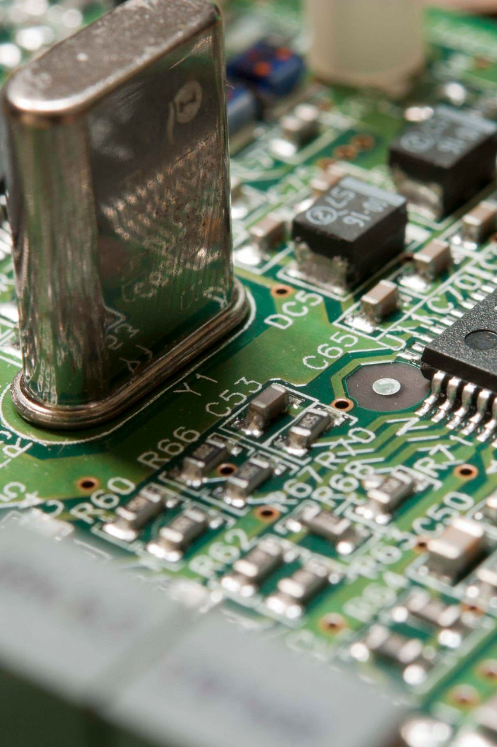
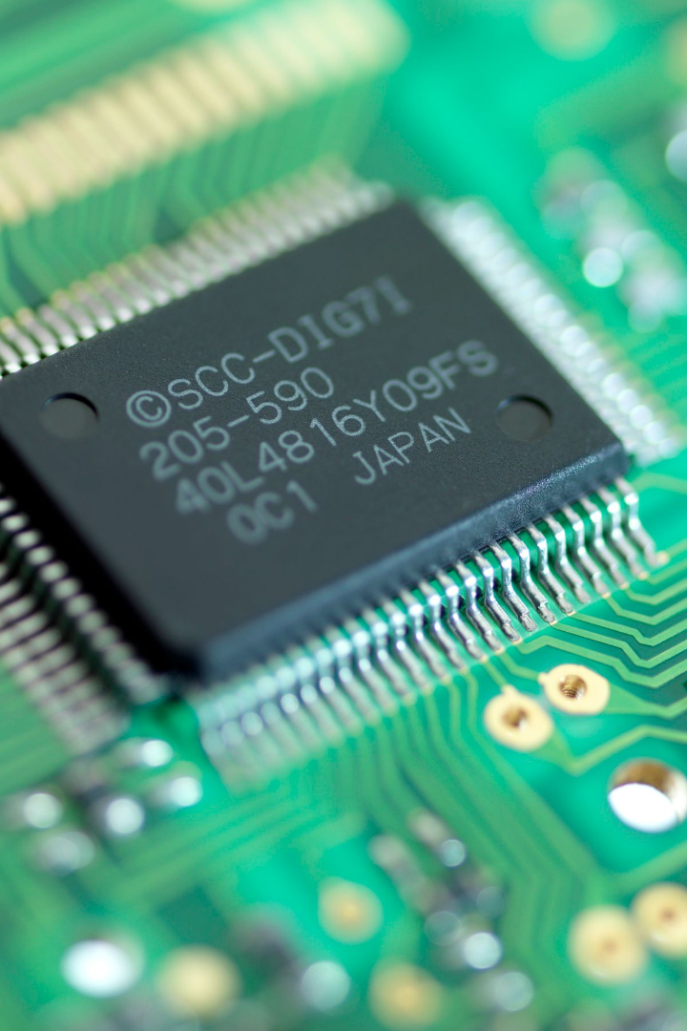

Bangladesh University of Business and Technology (BUBT)
Intel 8087 Family Microprocessor
In this presentation, we will explore the features, capabilities and inner workings of these microprocessors
Course Title: Microprocessor
Course Code: CSE 315
To
Nourin Khandaker
Lecturer, Department of Computer Science and Engineering, BUBT
By
5 | 21224103083 | Yasir Rabbani Tanvir
 | 21224103184 | Raihan Sheikh Joy
 | 21224103074 | Abu Rayhan Emon
 | 21224103053 | M.Ridwane Islam Roky
 | 21224103068 | Mejbahul Islam Murad
 | 20215103051 | Shema Akter
 | 19203103035 | Shahinur Islam Popy
 | 21224103050 | Pervej Khandakar

Slide 2

Overview of Microprocessors
1
Brain of Computers
2
Small yet Powerful
3
Scalable and Versatile
Microprocessors serve as the brains of computers, handling complex calculations and executing instructions.
Microprocessors are compact electronic circuits that combine various components, such as arithmetic logic units and control units, on a single chip.
Microprocessors come in different sizes and performance levels, catering to a wide range of applications, from smartphones to server farms.

Slide 3
Intel 8087 family microprocessors are powerful integrated circuits that revolutionized computing.

Slide 4
Features of the 8087 Microprocessor
Architecture
Instruction Set
Floating-Point Operations
The 8087 microprocessor utilized a unique architecture that enabled efficient floating-point arithmetic operations.
The instruction set of the 8087 microprocessor allowed for complex mathematical calculations with high precision.
With the 8087 microprocessor, floating-point operations became faster and more precise, enabling accurate scientific and engineering calculations.

Slide 5
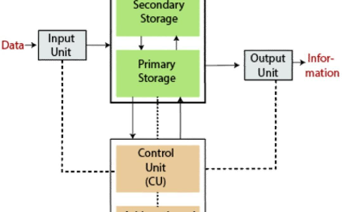
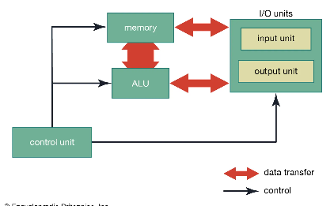
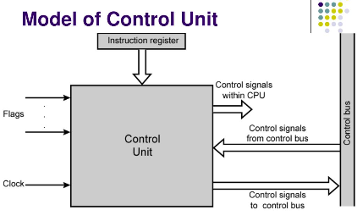
Block Diagram of Intel 8087 Family Microprocessor
Input/Output Block
Arithmetic Logic Unit (ALU
Control Unit
The input/output block facilitates the exchange of data between the microprocessor and external devices, enabling communication and interfacing capabilities.
The ALU performs complex arithmetic and logical operations, enabling mathematical calculations and decision-making within the microprocessor.
The control unit coordinates and controls the operations of other components within the microprocessor, ensuring proper execution of instructions.

Slide 6
Input/Output Block

Slide 7
Arithmetic Logic Unit (ALU)

Slide 8
Control Unit

Slide 9
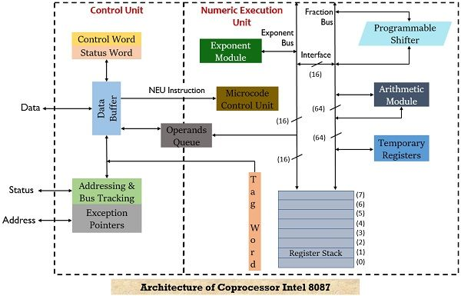

Slide 10
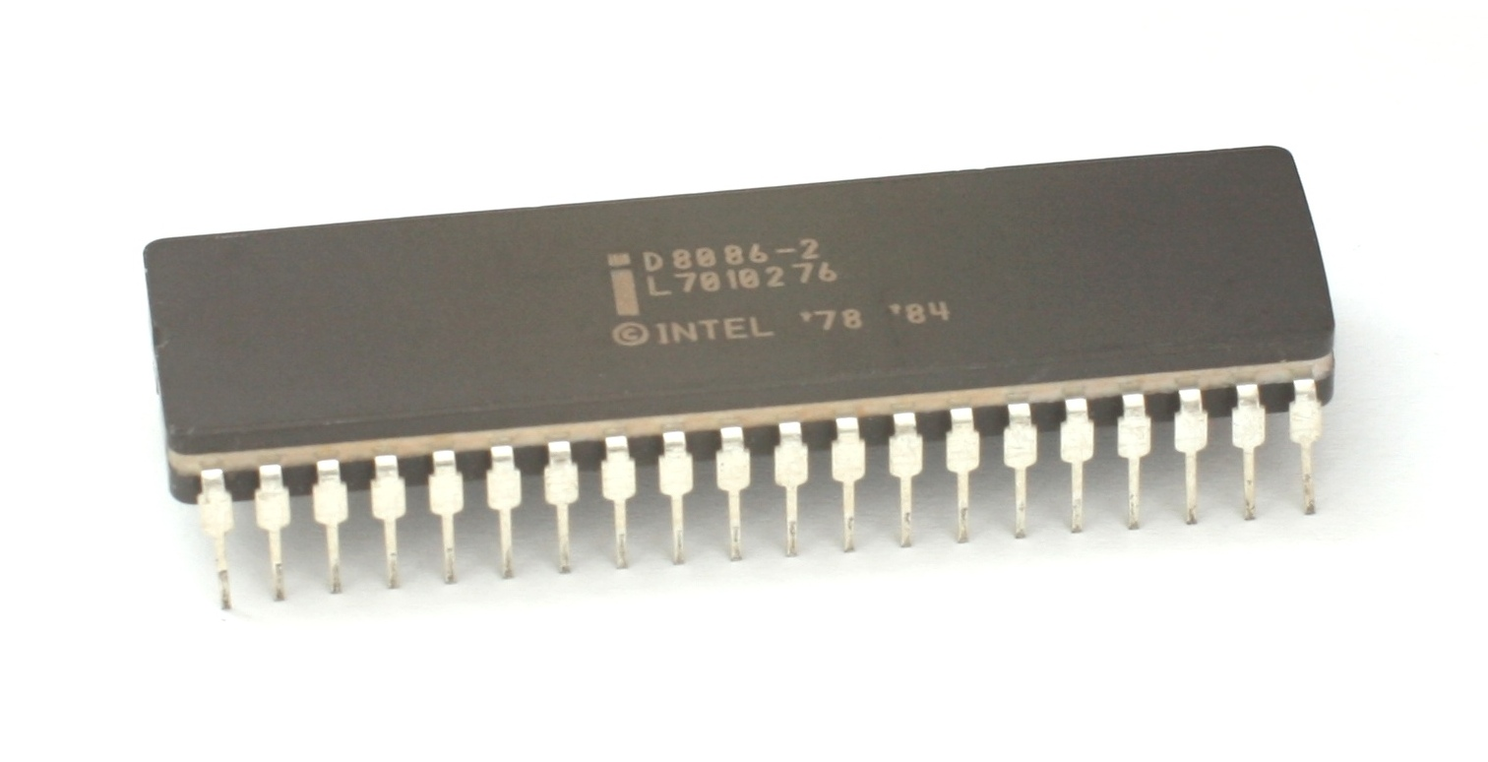
Functionality and Operation of Each Block
1
Input/Output Block
The input/output block manages the transfer of data between the microprocessor and peripheral devices, enabling communication and external interfacing functionalities.
Arithmetic Logic Unit (ALU)
2
The ALU performs arithmetic calculations, logical operations, and bitwise manipulation to process data and perform complex mathematical operations within the microprocessor.
3
Control Unit
The control unit coordinates and directs the flow of data and instructions within the microprocessor, managing the execution of operations and ensuring proper sequencing.

Slide 11
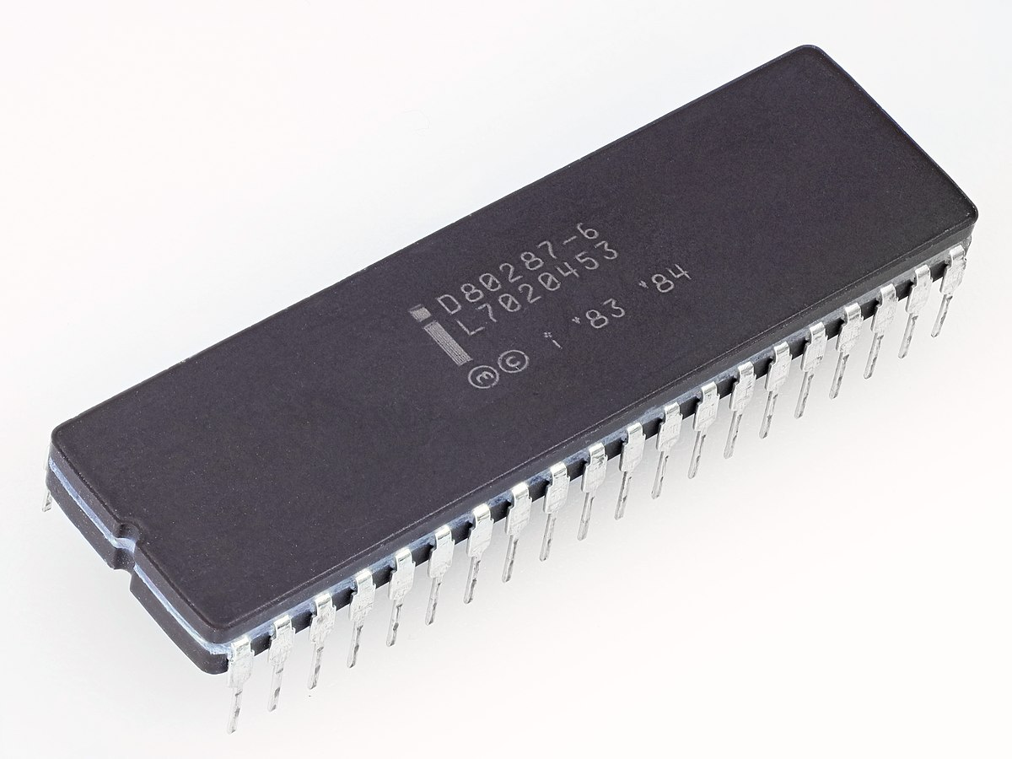
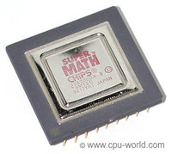
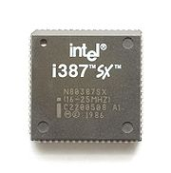
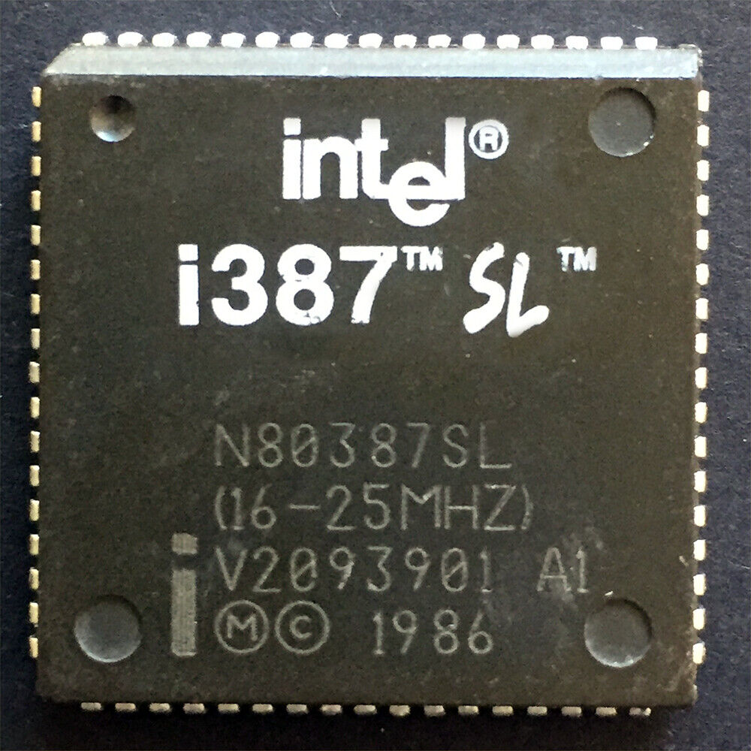
Subsequent members of the 8087 family :
80387
8087
80387SL
80387SX

Slide 12
Any questions?

Slide 13
Thank you

